Slide 1
Causal Consistency - COPS
Lecturer: Ngo Huy Bien
Software Engineering Department
Faculty of Information Technology
VNUHCM - University of Science
Ho Chi Minh City, Vietnam
nhbien@fit.hcmus.edu.vn

Slide 2

Objectives

Slide 3

Contents

Slide 4

References
http://nil.csail.mit.edu/6.824/2020/schedule.html
Leslie Lamport (1979). How to Make a Multiprocessor Computer That Correctly Executes Multiprocess Programs.

Slide 5
the setting: geo-replication for big web sites
[ 3 datacenters, users, web servers, sharded storage servers ]
multiple datacenters
each datacenter has a complete copy of all data
reads are local -- fast common case
what about writes?
what about consistency?

Slide 6
we've seen two solutions for geo-replication
Spanner
writes involve Paxos and perhaps two-phase commit
Paxos quorum for write must wait for some remote sites
no one site can write on its own
but has read transactions, consistent, fairly fast
Facebook / Memcache
writes must go to the primary site's MySQL
again, non-primary sites cannot write on their own
but reads are blindingly fast (1,000,000 per second per memcache server)

Slide 7
can we have a system that allows writes from any datacenter?
so a write can proceed without talking to / waiting for any other datacenter?
would help fault tolerance, performance, robustness vs slow WAN
these local reads and writes are the real goal
the consistency model is a secondary consideration
we'll make one up that matches whatever our local read/write design has to do

Slide 8
straw man one
three data centers
set of shards in each datacenter
client reads and writes just contact local shard
each shard pushes writes to other datacenters, shard-to-shard, asynchronously
lots of parallelism
this design favors reads
could instead have writes be purely local, and reads check other datacenters
or quorum, with overlap, as in Dynamo/Cassandra

Slide 9
straw man one is an "eventually consistent" design
1. clients may see updates in different orders
2. if no writes for long enough, all clients see same data
a pretty loose spec, many ways to implement, easy to get good performance
used in deployed systems, e.g. Dynamo and Cassandra
but can be tricky for app programmers
example app code -- a photo manager
C1 uploads photo, adds reference to public list:
C1: put(photo) put(list)
C2 reads:
C2: get(list) get(photo)

Slide 10
Sequential Consistency [2]
Sequential consistency: the result of any execution is the same as if the operations of all the processors were executed in some sequential order, and the operations of each individual processor appear in this sequence in the order specified by its program.
Processor 1: print "Hello"; print "world!";
Processor 2: print "Hi!";
Sequential order 1: Hello world! Hi! Ok.
Sequential order 2: Hello Hi! world! Ok.
Sequential order 3: world! Hello Hi! Not ok!

Slide 11
Sequential Consistency vs. Linearizability
Linearizability cares about time. Sequential consistency cares about program order.
Processor 1: print "Hello"; print "world!";
Processor 2: print "Hi!";
Sequential Consistency: Hello world! Hi! Ok.
Linearizability: Hello world! Hi! Not ok.
Sequential Consistency: Hello Hi! world! Ok.
Linearizability: Hello Hi! world! Ok.

Slide 12
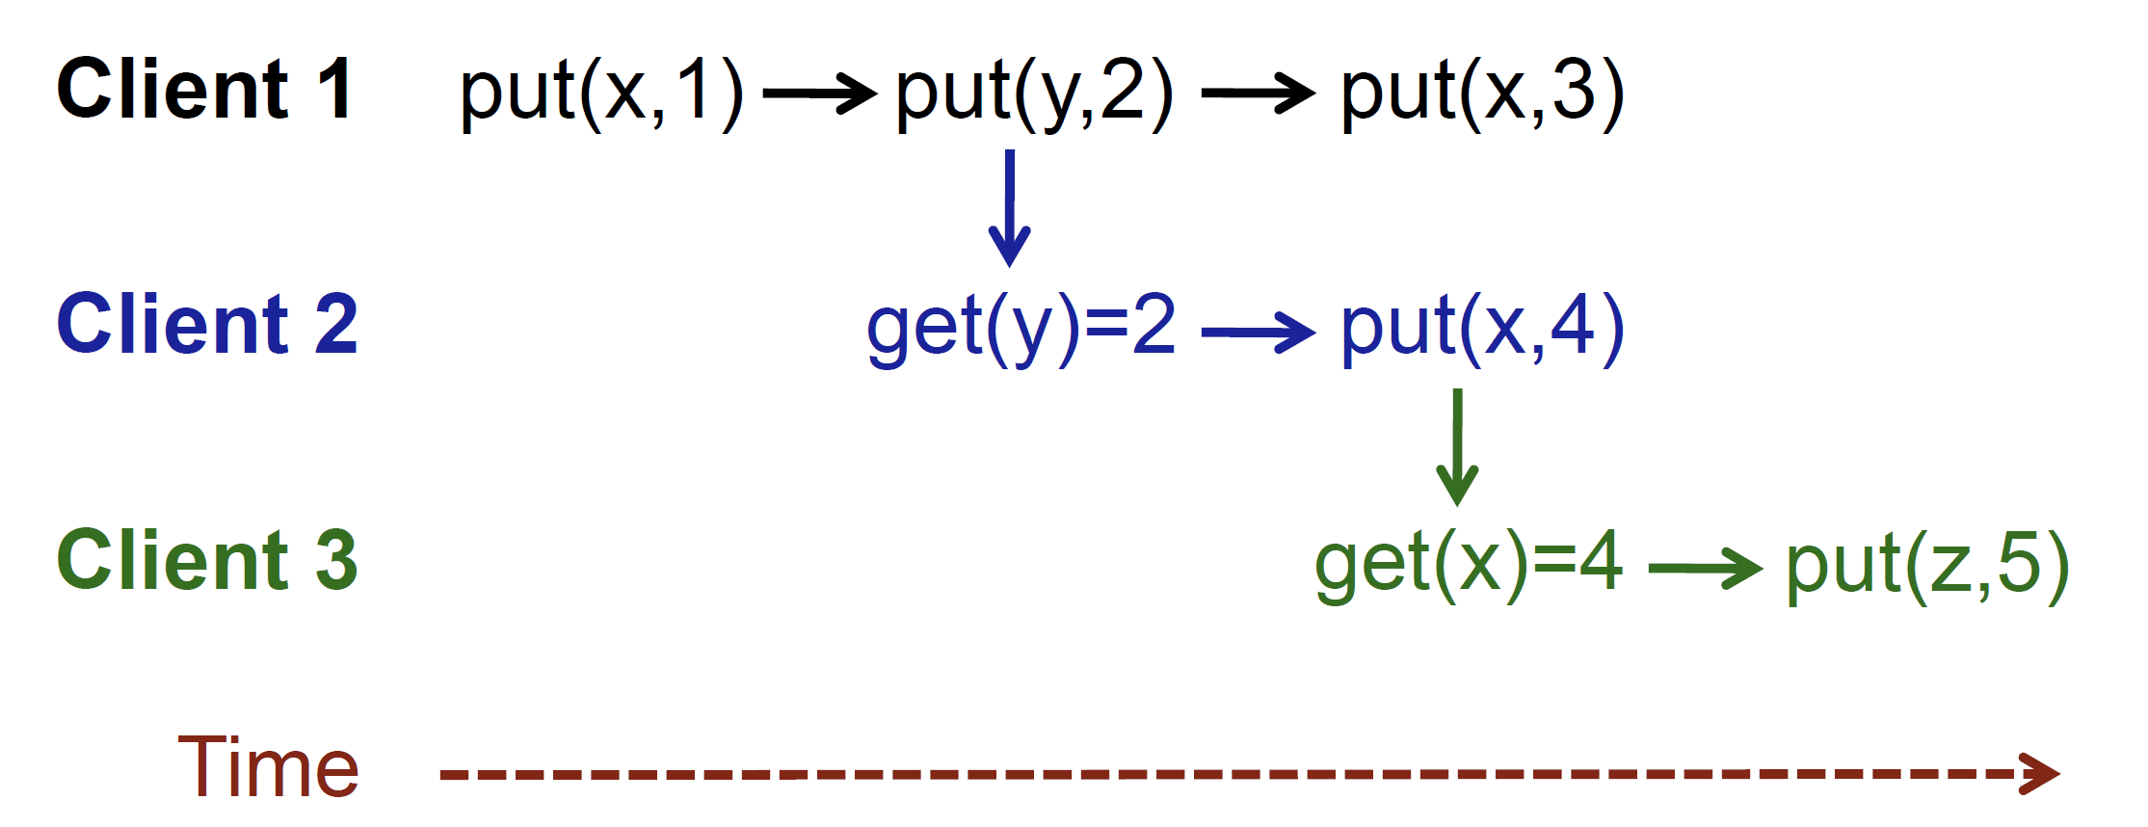
causal consistency
Linearizability > Sequential > Causal > FIFO > Eventual

Slide 13
Further Research

Slide 14

Thank You & See You Again

